Slide 1

Using Generative Adversarial Networks for PPP Loan Fraud Anomaly Detection
Rose Hemans

Slide 2
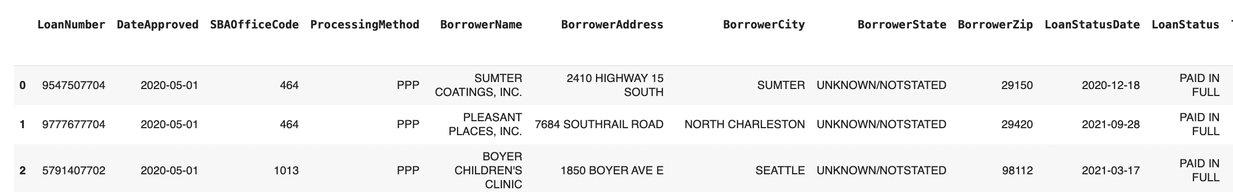
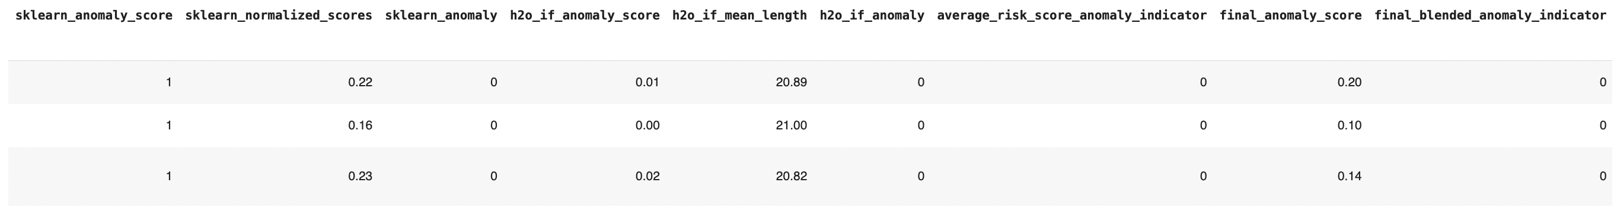
Paycheck Protection Program (PPP) Loan Dataset
965,548 loans
Dataset includes anomaly scores from three anomaly detection models (two Isolation Forest models + one manual deviance risk score algorithm
Notes:
Other project = blended ensemble anomaly detection using two isolation forest models and one manual deviance risk score algorithm

Slide 3
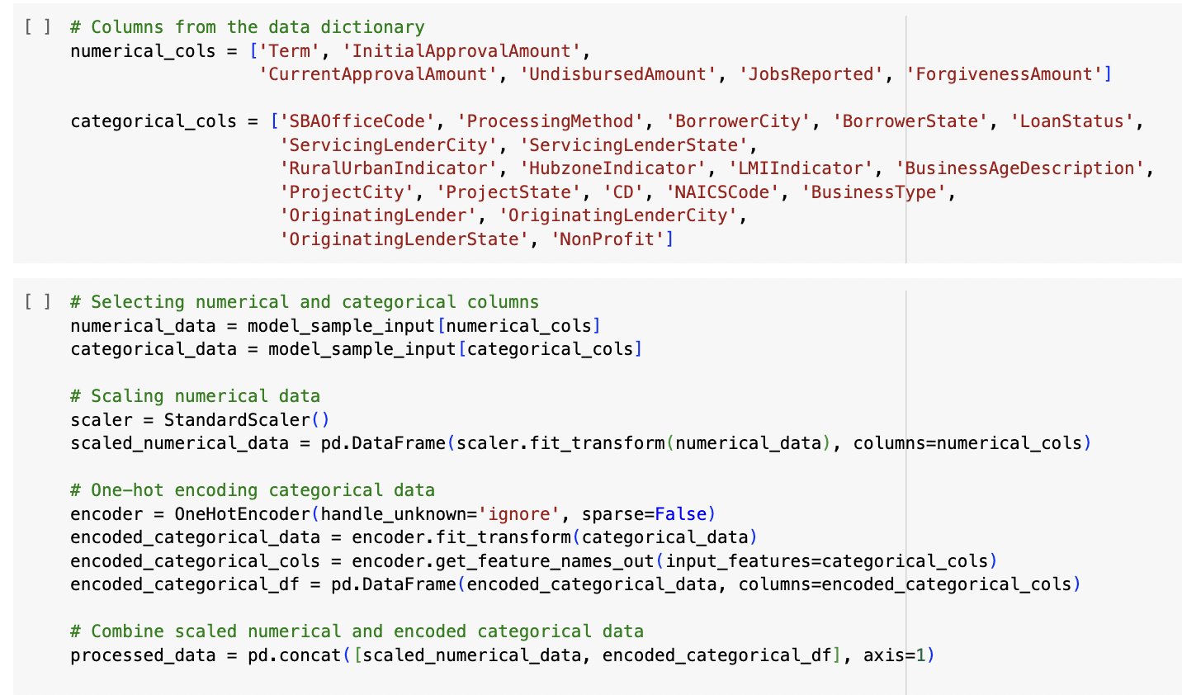
Final data processing for GAN model
Scale numerical columns
One hot encoding of categorical columns
Split 80% training, 10% test, 10% validation
Notes:
Other project = blended ensemble anomaly detection using two isolation forest models and one manual deviance risk score algorithm

Slide 4

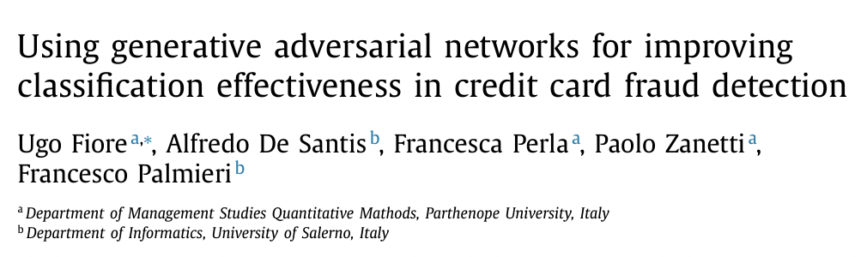
Papers Studied
Notes:
The two papers I studied were on:
Coupled Infinite Gaussian Mixture Model with General Adversarial Networks for multimodal anomaly detection (paper focuses on GPS trajectory data of taxi drivers to determine anomalous traffic patterns and identify which drivers are fraudulently inflating journey times to scam customers) (2019)
Using GANs for credit card fraud detection by oversampling fraudulent transactions only and training the GAN to output the generated minority class of fraudulent transactions, merging this generated data with the original sample and then running a classifier model to improve the model’s effectiveness

Slide 5
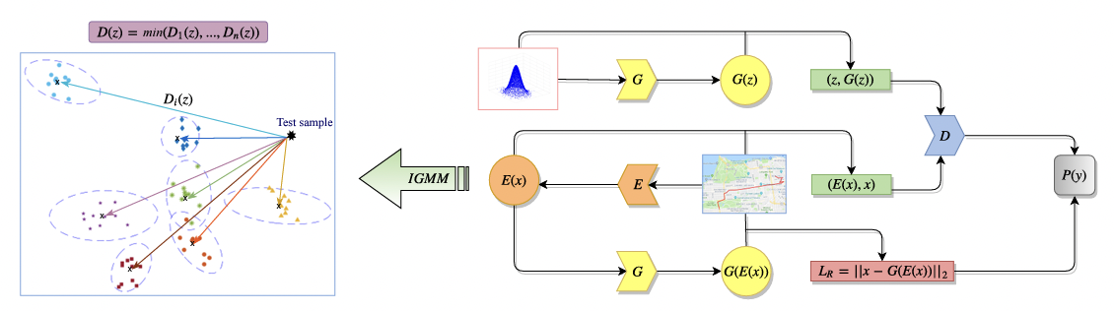
Coupled IGMM-GAN Model Architecture
Notes:
Generator Network: It takes random noise (Gaussian samples) as input and learns to create new trajectories that resemble real taxi rides.
Discriminator Network: It learns to differentiate between the actual GPS trajectories (real trips) and the synthetic ones created by the generator (fake trips).
Encoder Network: learns the inverse mapping of the generator's output, essentially understanding how the synthetic trips are embedded in the latent space. It helps to reconstruct or understand the latent space representation of the generated trajectories.
Multimodal Mahalanobis Distance Metric: The GAN generates a Multimodal Mahalanobis Distance Metric from an Infinite Gaussian Mixture Model (IGMM). This metric is utilized to detect outliers or anomalies in new, unseen GPS trajectory data. Anomalies are typically instances that significantly deviate from the learned normal patterns in the trajectories, flagged by this distance metric.

Slide 6
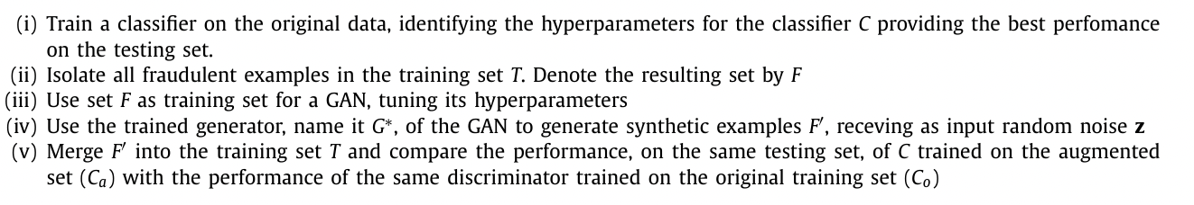
Credit Card Fraud GAN Model Architecture
Publicly available dataset containing 284,807 credit card transactions
446 positive class examples (i.e., fraudulent transactions) account for 0.185% of 170,236 training set transactions
Notes:
Hyperparameters for the GAN were empirically determined similarly to what had been done for the hyperparameters of the classifier.
The discriminator D is a 3-layer perceptron with each of the hidden layers composed of 36 Sigmoid units.
The generator G also has three layers, with ReLu units in the first two and Sigmoid units in the third one.
The dimension of the noise vector z was set to 100.

Slide 7
Problem Task
Unsupervised anomaly detection problem
Instead of a classifier for known fraudulent loans, we use the blended anomaly detection models from previous project and compare similarity of predictions for each subset of anomalies to the entire dataset
Objective:
Can we calculate an overlap in anomalous loans identified by the GAN model vs the Isolation Forest blended models?
generate convincing examples of the fraudulent loans that can be used to re-balance the training sets used by the isolation forest models.
Notes:
Problems:
Class Imbalance (Large number of normal loans vs potentially fraudulent)
Unsupervised learning task means we don’t have a real test set of known fraudulent loans, and still have imbalance problem
Essentially there is no framework for this type of problem and it requires some exploratory model building to establish ground work

Slide 8
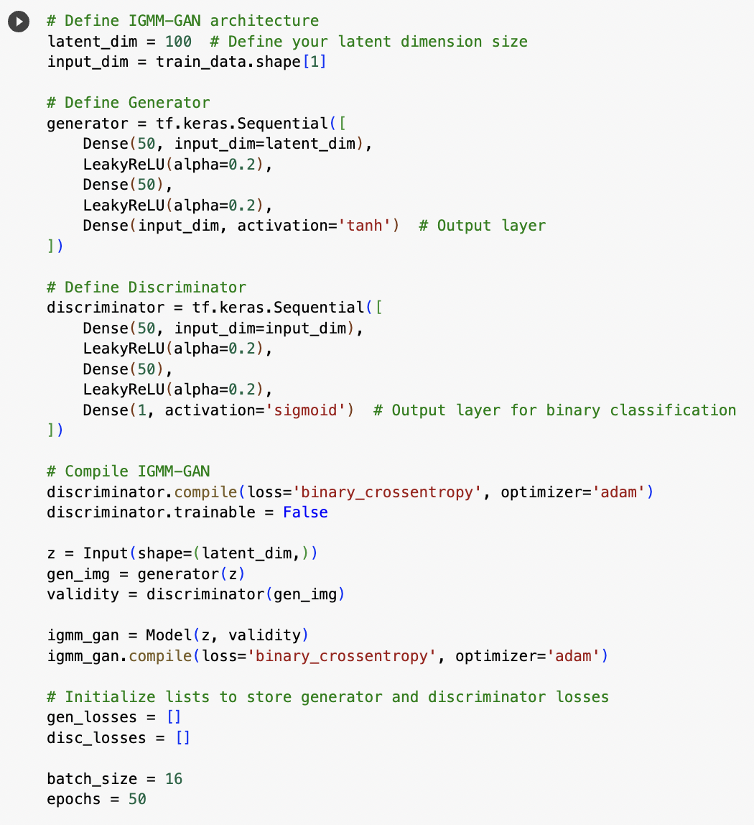
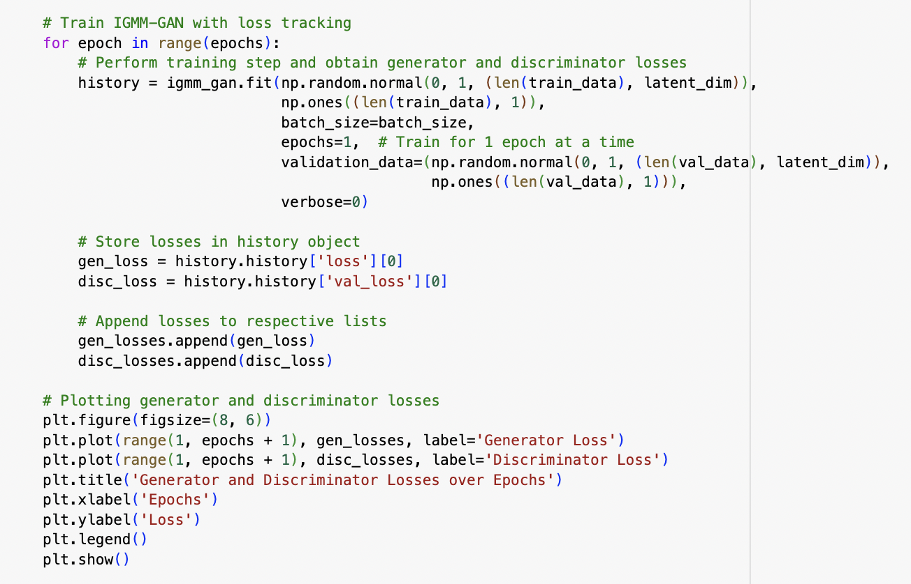
My GAN Model Architecture
Notes:
Train shape: (7724, 11611)
Generator:
Input: Latent space of dimension 100.
Layers:
Dense layer with 50 units and LeakyReLU activation - Dense layer with 50 units and LeakyReLU activation. (AVOID DEAD NEURONS, ROBUST TO NOISE)
Output layer with the number of units matching input_dim and tanh activation.
Discriminator:
Input: Input dimension obtained from the shape of the training data.
Layers:
Dense layer with 50 units and LeakyReLU activation - Dense layer with 50 units and LeakyReLU activation. (SPARSE ACTIVATION IN LEAKYRELU IDEAL FOR CAPTURING ANOMALIES)
Output layer with 1 unit using sigmoid activation for binary classification.
Compilation:
Discriminator: Compiled using binary cross-entropy loss and Adam optimizer. (BINARY LOSS FOR BINARY CLASSIFICATION)
GAN: Combined model composed of the generator and discriminator.
Compiled using binary cross-entropy loss and Adam optimizer.
Training Parameters:
Batch Size: 16
Epochs: 50

Slide 9
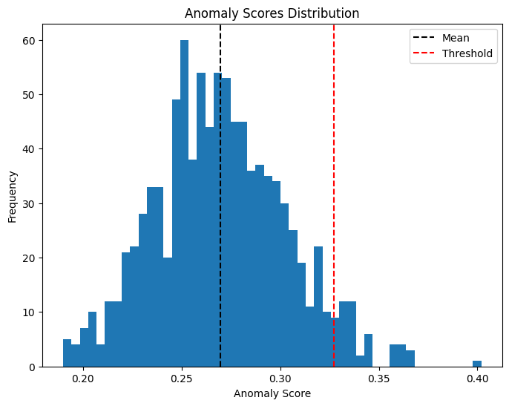
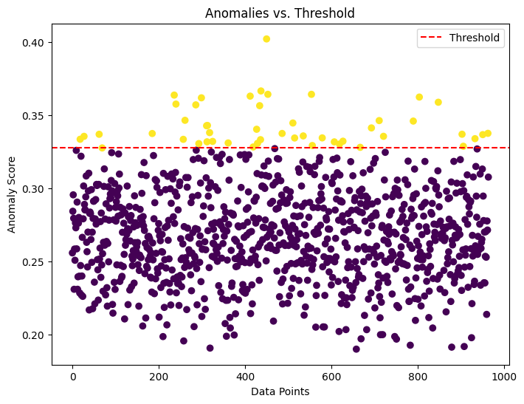
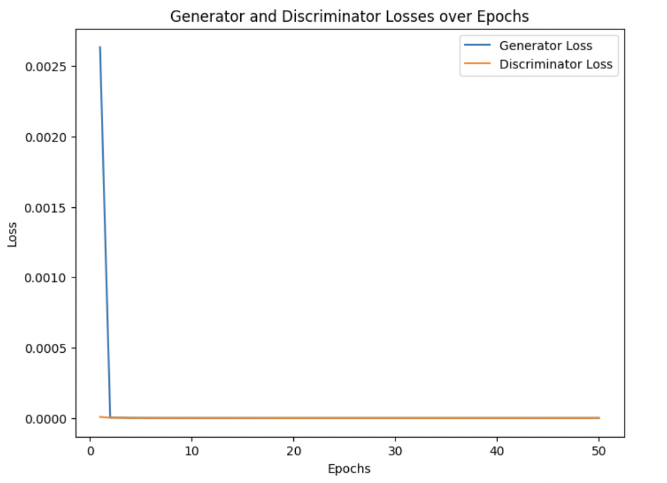
My GAN Model Architecture
Notes:
Generator Convergence: A rapid decrease in the generator loss signifies that the generator network is converging quickly to produce outputs that the discriminator perceives as increasingly similar to real data. In this case, the generator is producing synthetic data that resembles the real data more closely as training progresses.
Discriminator Saturation: The discriminator loss reaching and plateauing at 0.0000 suggests that the discriminator has reached a point where it can effectively distinguish between real and generated samples. It has possibly achieved a level of accuracy where it consistently identifies fake data as fake and real data as real.
Mode Collapse Possibility: The constant discriminator loss at 0.0000 for the entire duration might indicate that the discriminator has not faced diverse enough samples to learn effectively or that the generator has possibly entered a mode collapse, generating limited or similar samples repeatedly.
Network Stability: While a constant loss can suggest stability, in GAN training, it's crucial to monitor both losses simultaneously. Such behavior can sometimes indicate instability or a lack of diversity in the generated samples.

Slide 10
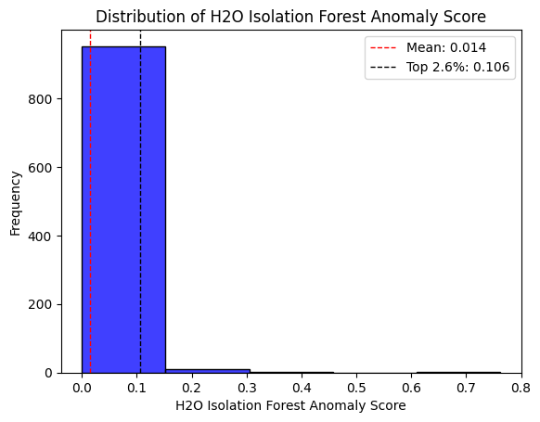
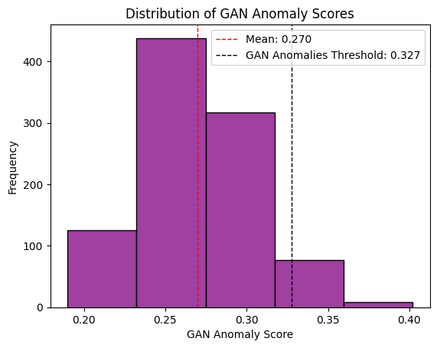
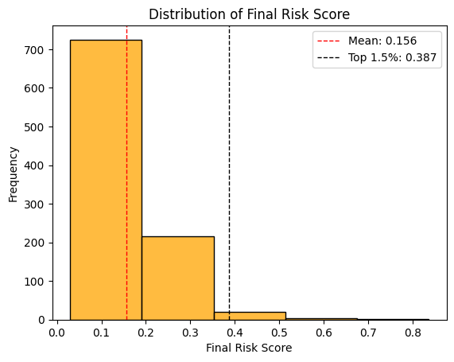
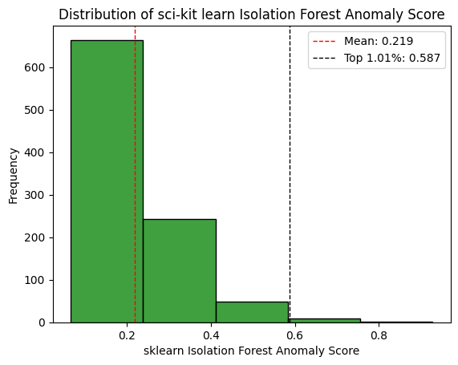
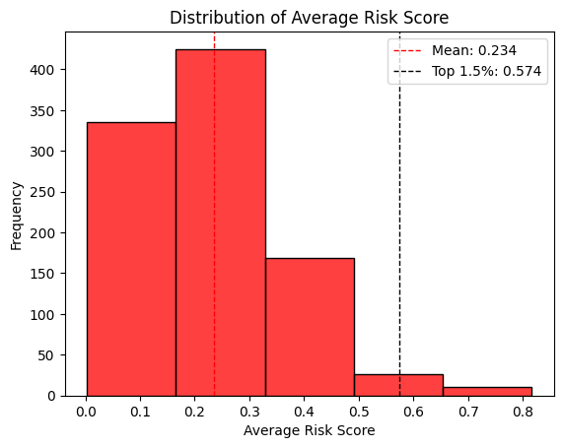
Anomaly Scores Distribution

Slide 11
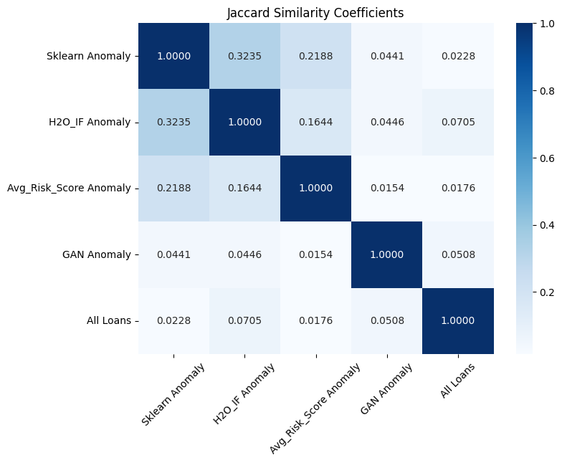
My GAN Model Architecture
Notes:
:The GAN anomalies had the second highest intersection (0.0508) with all loans, next to the H2O Isolation Forest anomalies (0.0705).

Slide 12
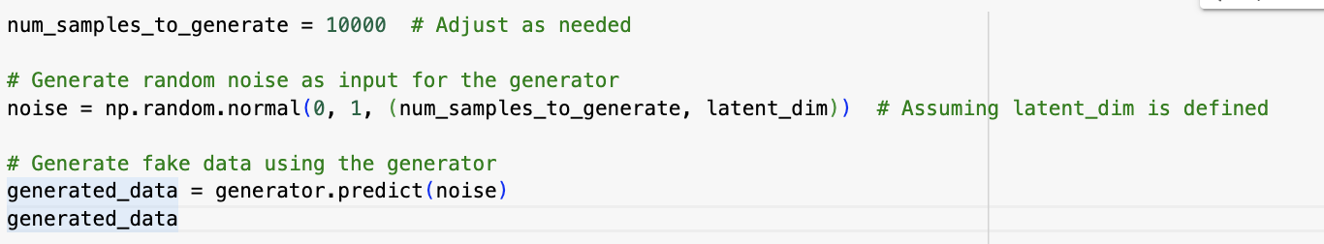
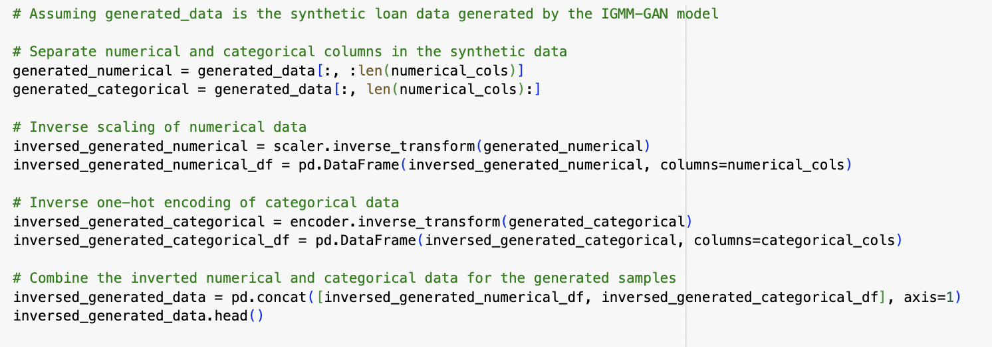
Generating Fake Data
Notes:
:The GAN anomalies had the second highest intersection (0.0508) with all loans, next to the H2O Isolation Forest anomalies (0.0705).

Slide 13
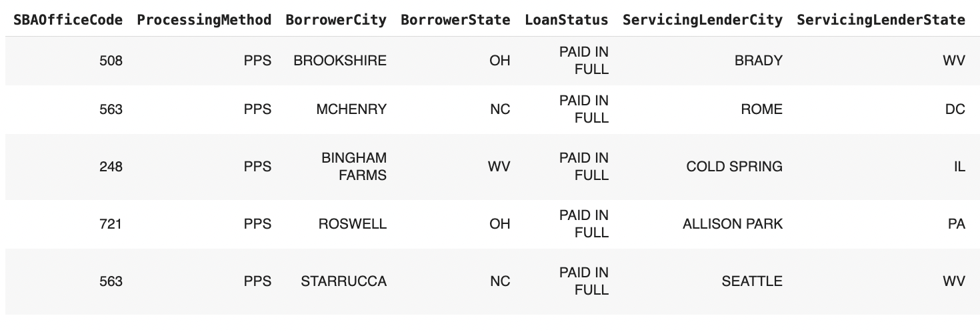
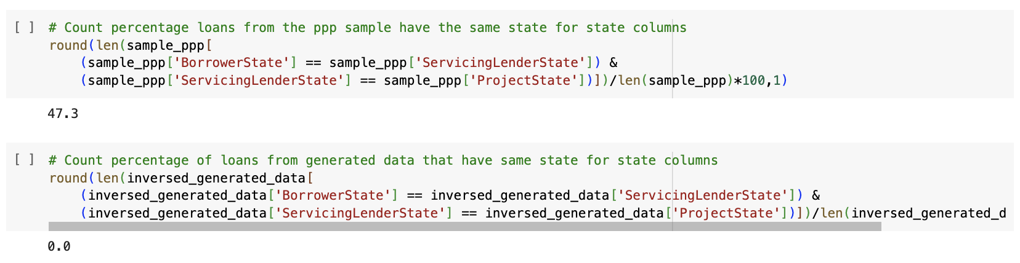
Generating Fake Data
Notes:
:The GAN anomalies had the second highest intersection (0.0508) with all loans, next to the H2O Isolation Forest anomalies (0.0705).
For index 0:
* There is only one city in the US called Brookshire and it is in Texas.
* The BorrowerCity is Brookshire but the BorrowerState is Ohio, not Texas.
* There is no city called Brady in West Virginia, but there is a Morristown in Texas.
* The Service Lender State (WV) and, Borrower State (OH), and Project State (CT) are all different.
For index 1:
* Bingham Farms is a village in Michigan, it does not exist in West Virginia.

